Slide 1
MERN STACK

Slide 2
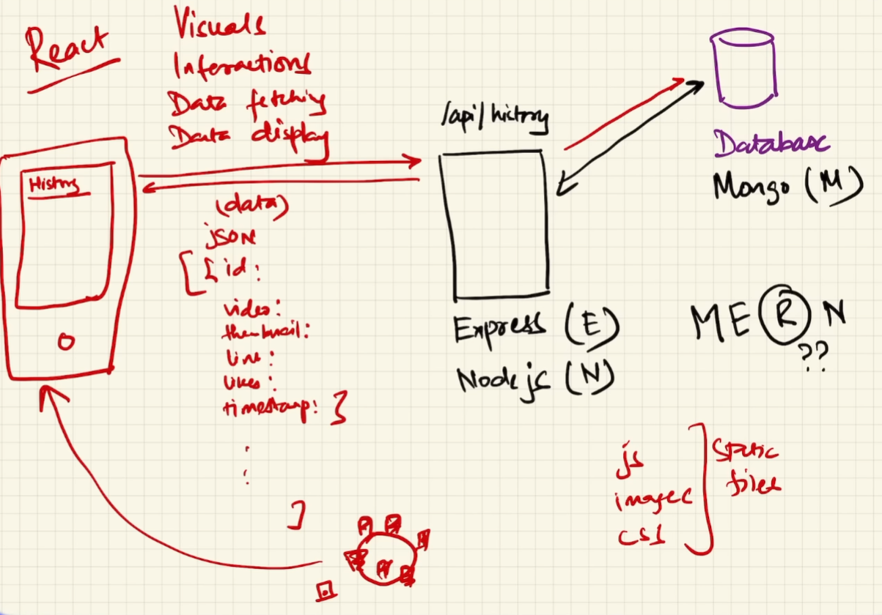
Notes:
CDN server are Netlify and Vercel (there can be other server). Static server and CDN are used interchangeably.
CDN in the context of the MERN stack typically stands for "Content Delivery Network."
API server and DataBase Express.js is a web application framework for Node.js, designed to build web applications and APIs quickly and efficiently. It provides a middleware support for handling requests and responses, routing, template engines, and much more.

Slide 3
React Tutorial
React is a JavaScript library for building user interfaces.
React is used to build single-page applications.
React allows us to create reusable UI components.
React, sometimes referred to as a frontend JavaScript framework, is a JavaScript library created by Facebook.
React only changes what needs to be changed!
Notes:
React is a JavaScript library created by Facebook.
React is a tool for building UI components.
React creates a VIRTUAL DOM in memory.
React only changes what needs to be changed!

Slide 4
React Installation
First check node version through cmd. Node -v
Install node.js if not installed
Npm create vite@latest
Give project name
Then go to project folder and install third party deficiencies npm i or(install)
Npm run dev.
Notes:
ReactDOM: ReactDOM is a package in React responsible for rendering React components into the DOM (Document Object Model). It provides methods for interacting with the DOM, such as rendering components, updating component states, and handling events.
createRoot: createRoot is a method introduced in React 18. It allows you to create a root for rendering React components inside a browser DOM node. This method initializes a new React root and returns an object representing it.
ReactDOM.createRoot(container) creates a new React root in the specified container (DOM node), enabling the rendering of React components within that container.

Slide 5
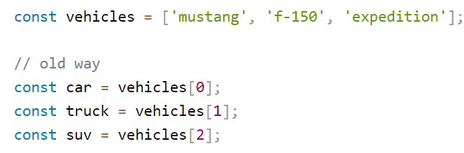
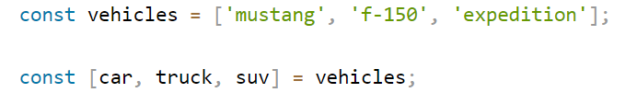
Destructuring:
Destructuring makes it easy to extract only what is needed.
Old way
New way
Notes:
JSX stands for JavaScript XML.
JSX allows us to write HTML in React.
JSX makes it easier to write and add HTML in React

Slide 6
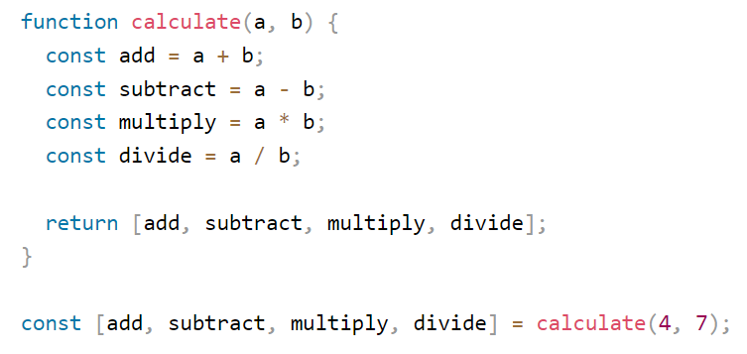
Example

Slide 7
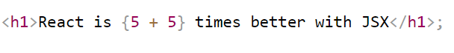
Expressions in JSX
With JSX you can write expressions inside curly braces { }.
The expression can be a React variable, or property, or any other valid JavaScript expression.
JSX will execute the expression and return the result:

Slide 8
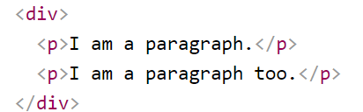
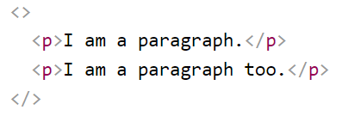
One Top Level Element
The HTML code must be wrapped in ONE top level element.
For Example:
This approach is not a good practice because we adding one extra tag div tag to the DOM.
To prevent unnecessarily adding extra nodes to the DOM. Use fragment. empty HTML tag: <></>.

Slide 9
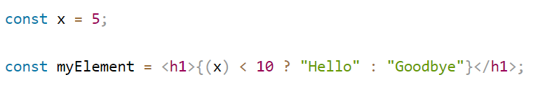
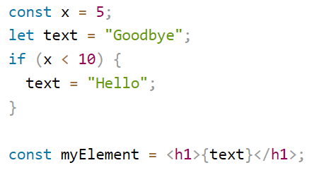
Attribute class = className and Conditions - if statements
The class keyword is a reserved word in JavaScript, Therefore not allowed to use it in JSX.
Use attribute className.
React supports if statements, but not inside JSX.
To be able to use conditional statements in JSX, put the if statements outside of the JSX, or use a ternary expression instead.

Slide 10
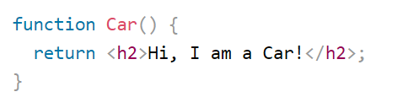
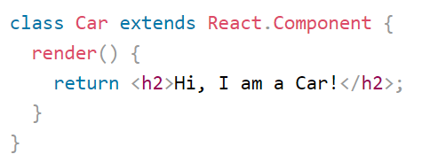
React Components
Components are like functions that return HTML elements.
Components are independent and reusable.
Components come in two types.
Class components
Function components
A class component must include the extends React.Component statement.
The component also requires a render() method, this method returns HTML.

Slide 11
Install Bootstrap
Npm i bootstrap@latest
Now how to import
import "bootstrap/dist/css/bootstrap.css";
Notes:
HMR stands for Hot Module Replacement. It's a feature provided by development tools like Webpack, Parcel, and React Fast Refresh that allows you to update code changes in your application without needing to do a full page reload or lose the current state of your application

Slide 12
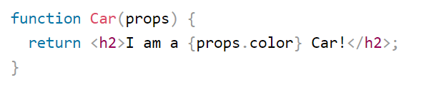
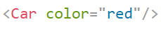
React Props
Components can be passed as props, which stands for properties.
Props are like function arguments, and we send them into the component as attributes

Slide 13
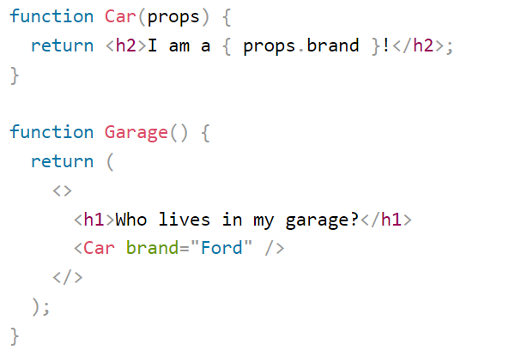
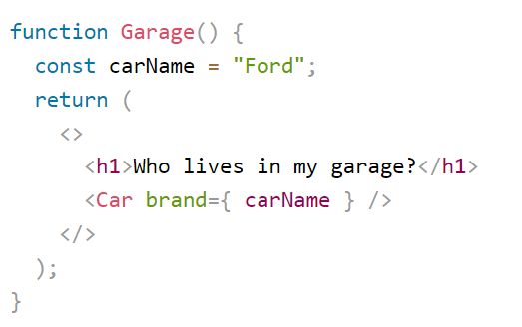
React Props

Slide 14
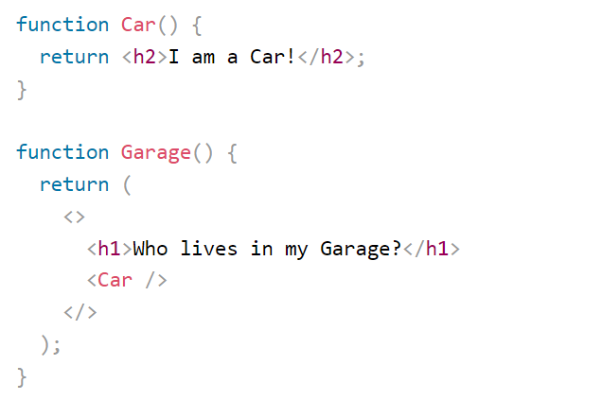
Components in Components
We can refer to components inside other components.
React is all about re-using code.

Slide 15
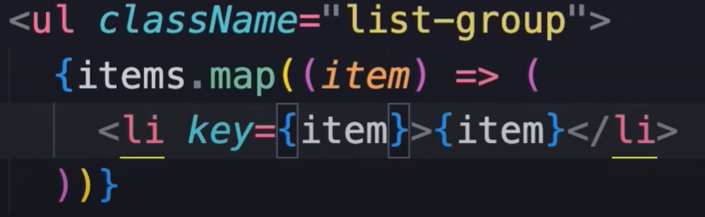
Map function
Notes:
Rendering content dynamically

Slide 16
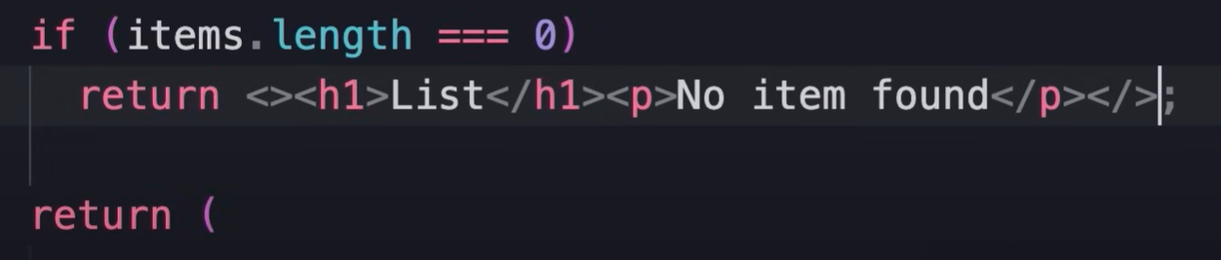
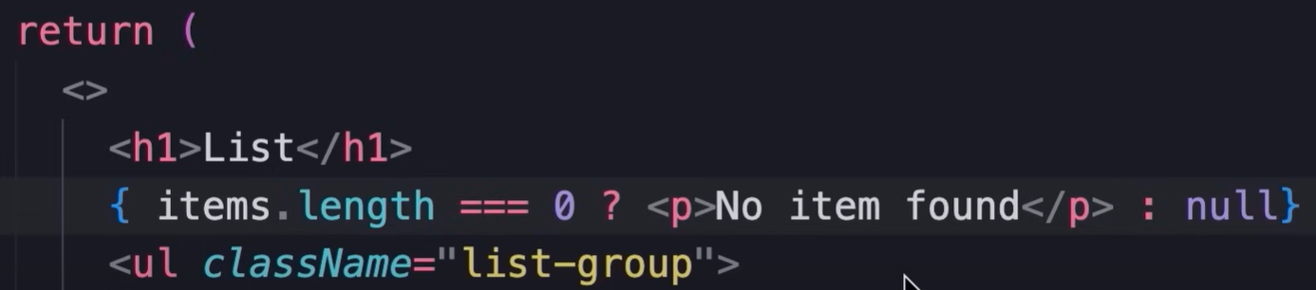
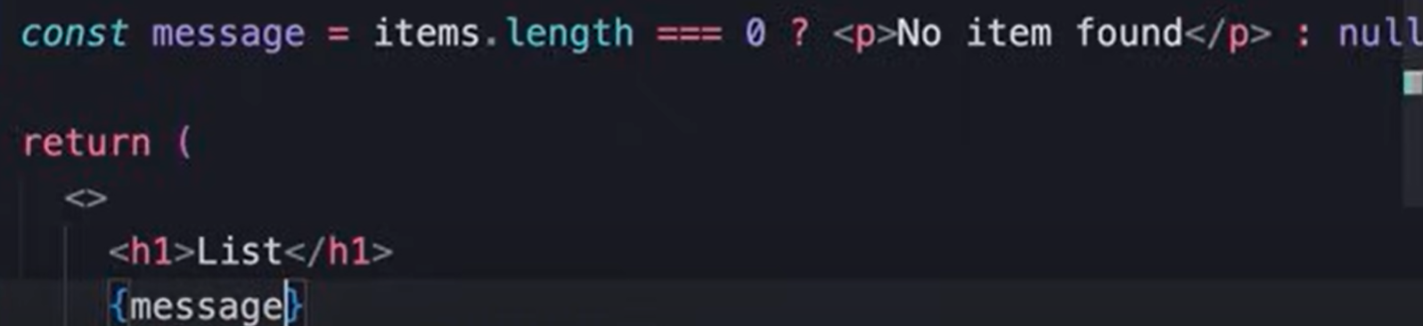
Conditional rendering

Slide 17
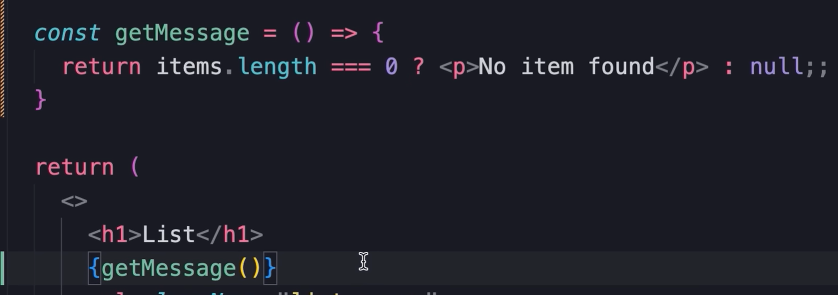
Conditional rendering

Slide 18
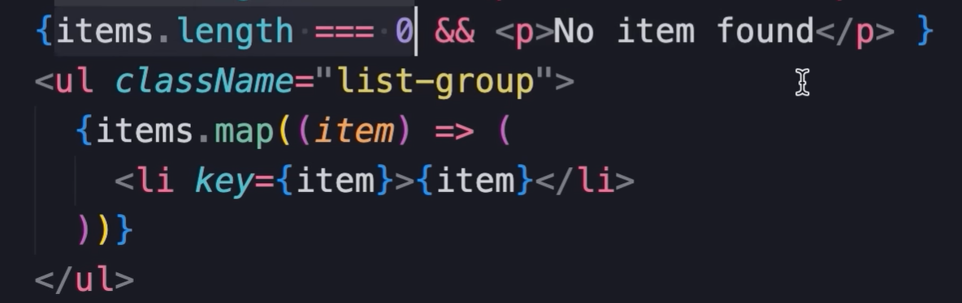
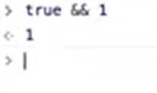
More concise and better way of Conditional rendering

Slide 19
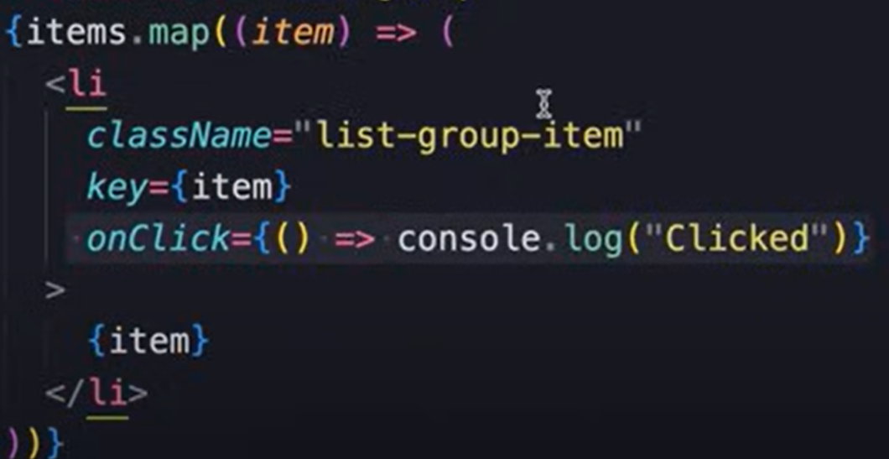

Handling events

Slide 20
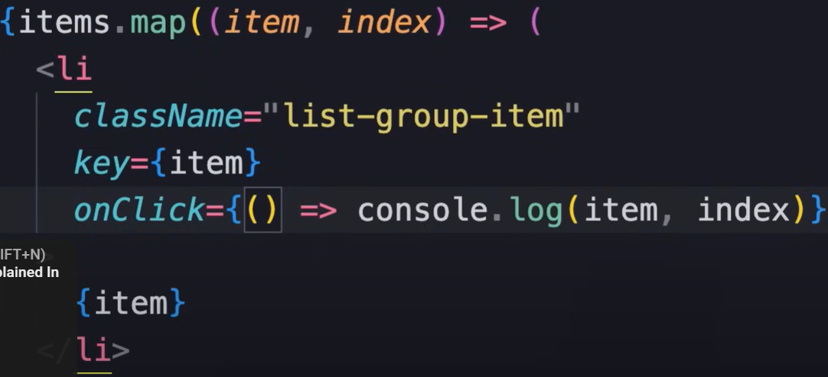
Handling events

Slide 21
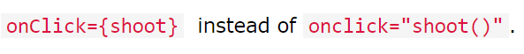
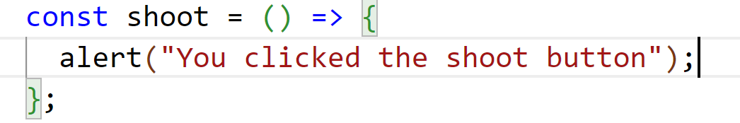
React Events
Just like HTML DOM events, React can perform actions based on user events.
React events are written in camelCase syntax:
onClick instead of onclick.
React event handlers are written inside curly braces:

Slide 22
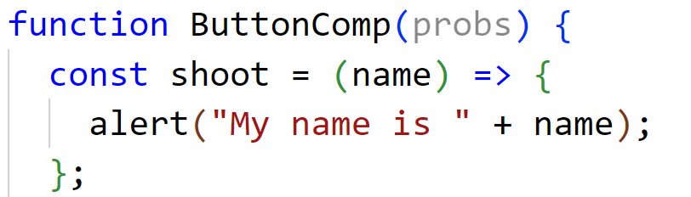
Passing Arguments to React Events

Slide 23
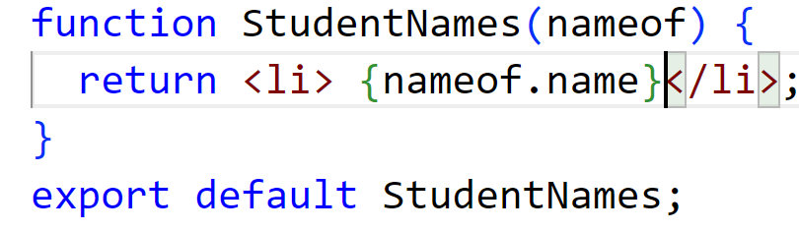
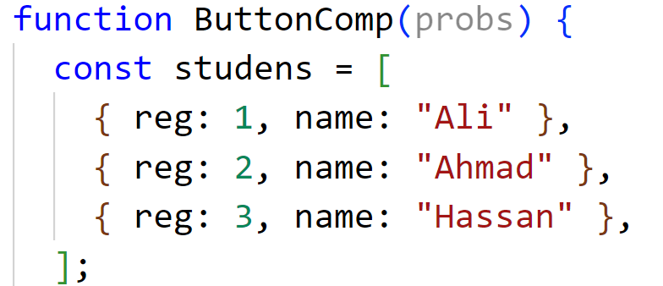
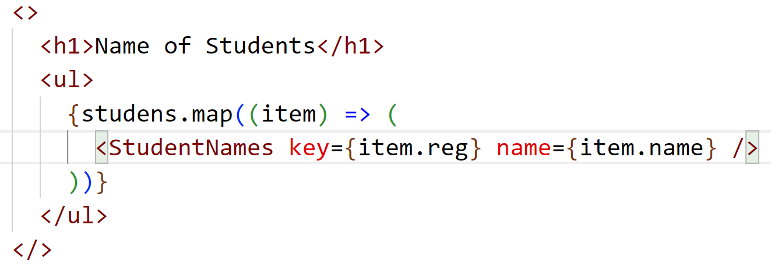
React List

Slide 24
React Event Object

Slide 25
React List

Slide 26
Adding Forms in React
In HTML, form data is usually handled by the DOM.
In React, form data is usually handled by the components.
When the data is handled by the components, all the data is stored in the component state.
We can control changes by adding event handlers in the onChange attribute.
We can use the useState Hook to keep track of each inputs value.

Slide 27
React Router
React App doesn't include page routing.
React Router is the most popular solution.
npm i react-router-dom or npm i react-router-dom@latest
Folder Structure
Within the src folder, we'll create a folder named pages with several files:

Slide 28
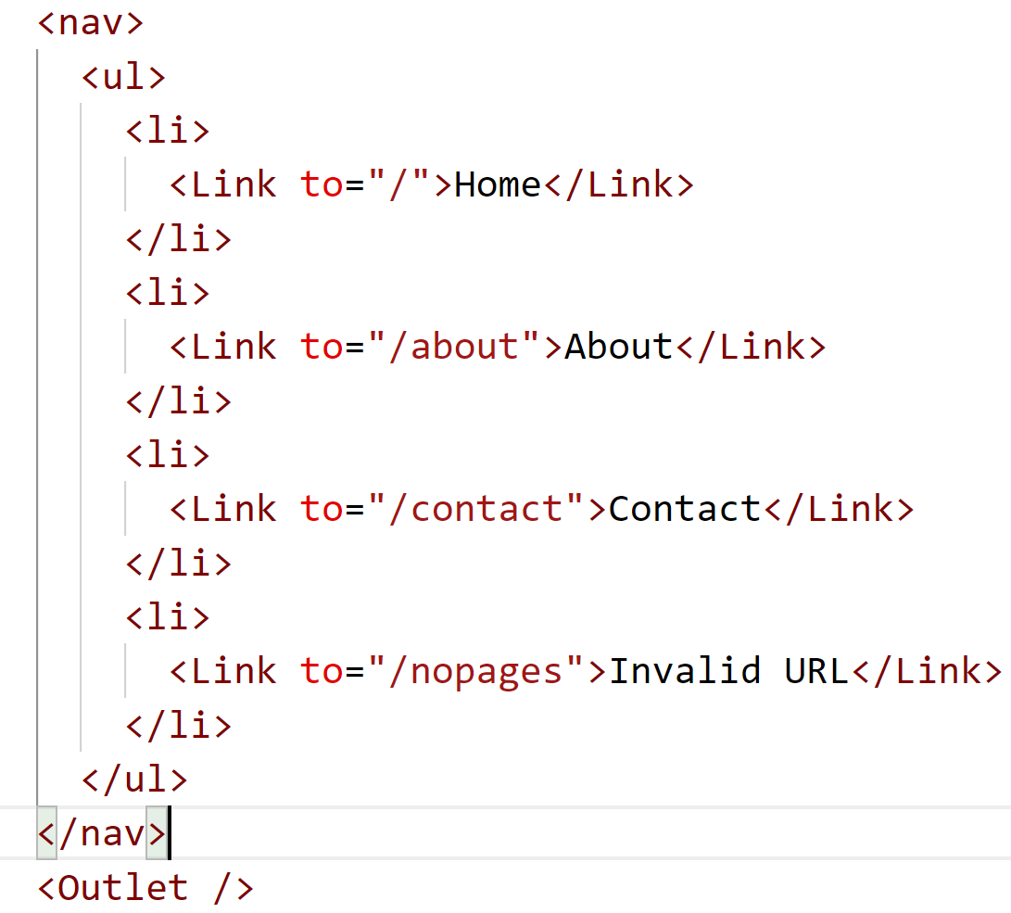
React Router
LayoutPage.jsx

Slide 29
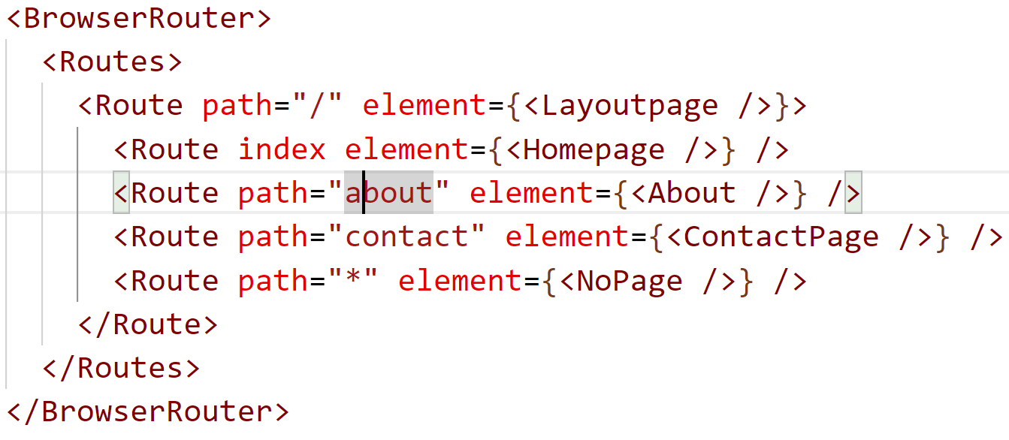
React Router
App.jsx

Slide 30
React Router
We wrap our content first with <BrowserRouter>.
Then we define our <Routes>.
An application can have multiple <Routes>.
<Route>s can be nested. The first <Route> has a path of / and renders the Layout component.
The nested <Route>s inherit and add to the parent route. So the About path is combined with the parent and becomes / About.
The Homepage component route does not have a path but has an index attribute. That specifies this route as the default route for the parent route, which is /.
Setting the path to * will act as a catch-all for any undefined URLs. This is great for a 404 error page.

Slide 31
React Hooks
Hooks generally replace class components, there are no plans to remove classes from React.
Hooks allow function components to have access to state and other React features.
We must import Hooks from react.
Hook Rules
Hooks can only be called inside React function components.
Hooks can only be called at the top level of a component.
Hooks cannot be conditional.

Slide 32
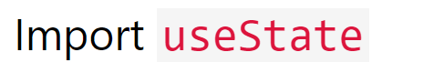
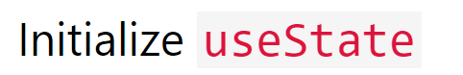
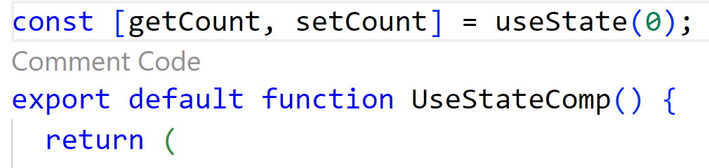
React useState Hooks
React useState Hook allows us to track state in a function components.
State generally refers to data or properties that need to be tracking in an application.
useState accepts an initial state and returns two values:
The current state.
A function that updates the state. a function components.
A variable that generally refers to data or properties that need to be tracking in an application.

Slide 33
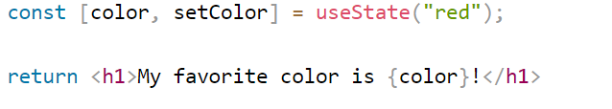
React useState Hooks
we are destructuring the returned values from useState.
The first value, getcount, is our current state.
The second value, setCount, is the function that is used to update our state.
We can now include our state anywhere in our component.

Slide 34
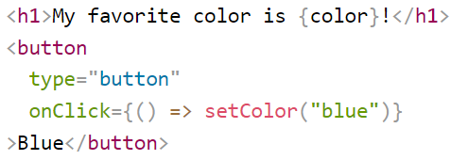
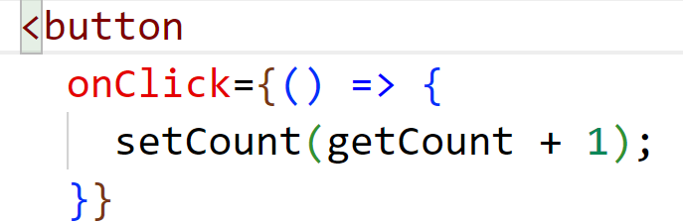
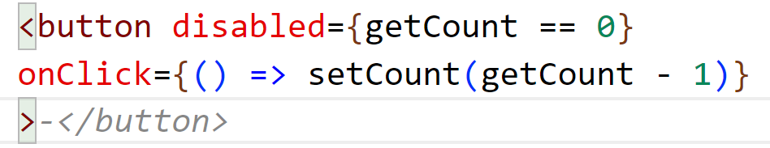
Update State

Slide 35
React useEffect Hooks
The useEffect Hook allows you to perform side effects in your components.
For instance: fetching data, directly updating the DOM, and timers.
useEffect accepts two arguments. The second argument is optional.
useEffect(<function>, <dependency>).
Syntax:
useEffect( () => {
//statements
}, [dependency])
The dependency argument is optional.

Slide 36
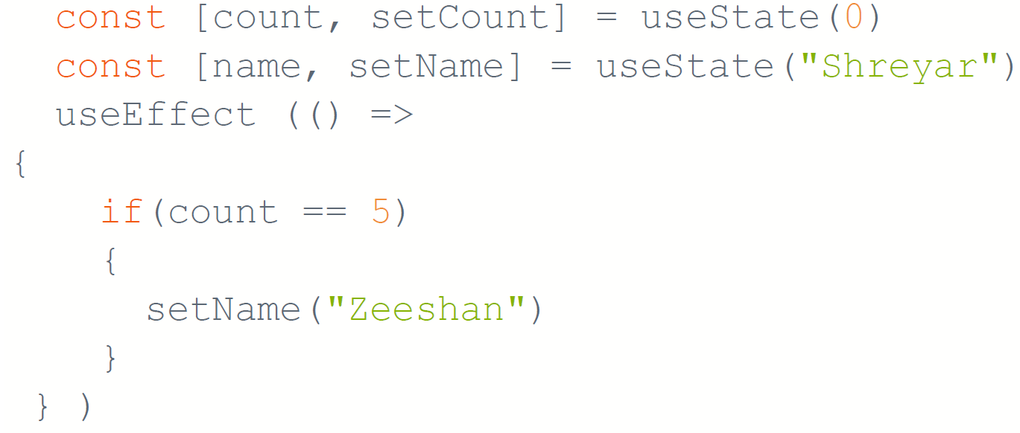
React useEffect Hooks
<h1> {name} </h1>
<button title="Add" onPress={() => setCount(count + 1)}> </button>
Notes:
That means that when the count changes, a render happens, which then triggers another effect.
There are several ways to control when side effects run

Slide 37
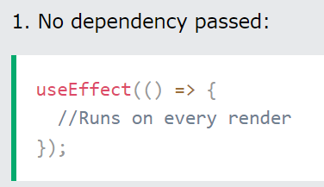
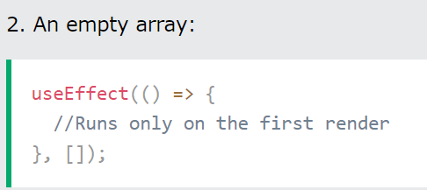
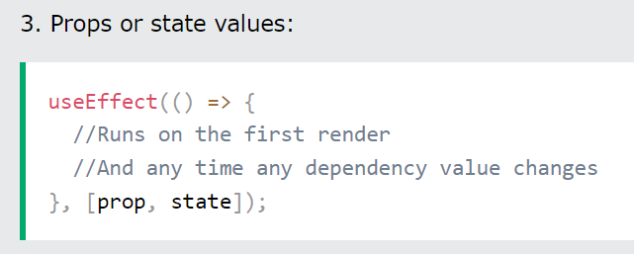
React useEffect Hooks
Notes:
That means that when the count changes, a render happens, which then triggers another effect.
There are several ways to control when side effects run

Slide 38
React useContext Hooks
React Context is a way to manage state globally.
It can be used together with the useState Hook to share state between deeply nested components more easily than with useState alone。
Problem
State should be held by the highest parent component in the stack that requires access to the state. To illustrate, we have many nested components. The component at the top and bottom of the stack need access to the state.
To do this without Context, we will need to pass the state as "props" through each nested component. This is called "prop drilling".
Notes:
That means that when the count changes, a render happens, which then triggers another effect.
There are several ways to control when side effects run

Slide 39
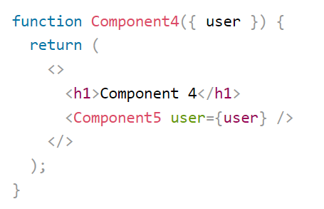
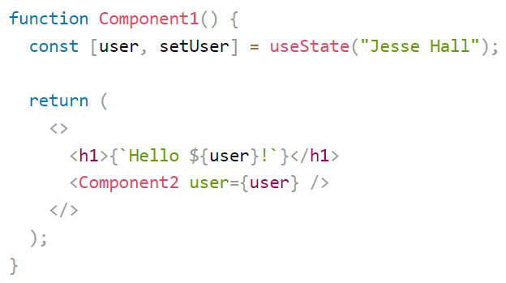
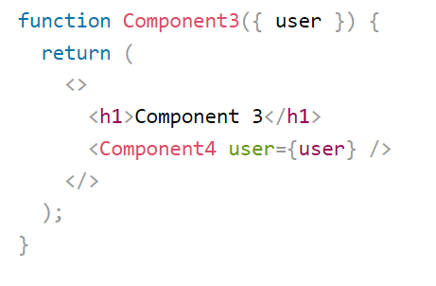
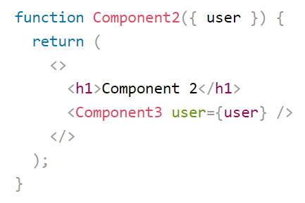
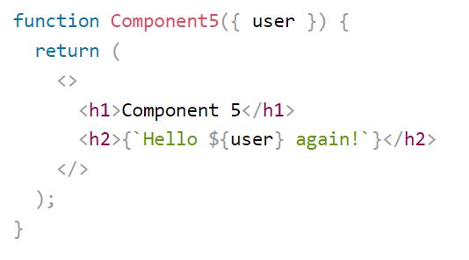
Problem （ prop drilling）

Slide 40
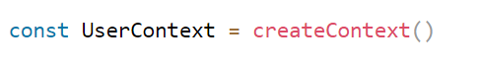

Solution (React useContext )
To create context, We must import createContext and initialize it:
Next use the Context Provider to wrap the tree of components that need the state Context.
Wrap child components in the Context Provider and supply the state value.
Now, all components in this tree will have access to the user Context.

Slide 41

Solution (React useContext )
Use the useContext Hook:
To use the Context in a child component, we need to access it using the useContext Hook

Slide 42
React useRef Hooks
The useState, which creates state variables that cause re-renders when they are updated.
For instance: If we tried to count how many times our application renders using the useState Hook.
we would be caught in an infinite loop since this Hook itself causes a re-render.
The useRef hook creates a mutable object whose value can be changed without causing re-renders
This makes useRef useful for storing values that we don't want to trigger re-renders.
Examples
Access DOM elements directly within functional components and focusing an input field, measuring the dimensions of an element, or triggering animation.
Storing Previous Values.: useRef can also be used to store previous values, especially when working with useEffect. This can be useful for comparing current and previous values, tracking changes, or performing cleanup actions.

Slide 43




React useRef Hooks
The useRef() only returns one item. It returns an Object called current.
We set the initial value: useRef(0).
It's like doing this: const count = {current: 0}. We can access the count by using count.current.

Slide 44

React useRef Hooks

Slide 45


Accessing DOM Elements in React useRef Hooks
useRef can be used to access DOM elements without causing issues.
Add a ref attribute to an element to access it directly in the DOM.
Notes:
In React, the ref attribute allows you to obtain a reference to a DOM element that is rendered by a React component.
This reference can then be used to interact with the DOM element imperatively, such as focusing the input, measuring its dimensions, or accessing its properties. In this example, when the button is clicked, the focusInput function is called, which focuses the input element using inputRef.current.focus(). This allows us to imperatively interact with the input element without needing to rely on React's state management or event handling.

Slide 46


Tracking State Changes in React useRef Hooks
useRef Hook can also be used to keep track of previous state values.
This is because we are able to persist useRef values between renders

Slide 47

React useReducer Hooks
The useReducer Hook is similar to the useState Hook.
It's an alternative to useState hook, especially when the state logic become complex or involves multiple sub-values or when the next state depends on the previous one.
The useReducer is a hook allows you to manage complex state logic in a more organized way.
Syntax
The useReducer Hook accepts two arguments

Slide 48


React useReducer Hooks
With useReducer, We define a reducer function that takes the current state and an action as arguments, and returns the new state based on that action.

Slide 49


React useReducer Hooks
We then use the useReducer hook by passing the reducer function and an initial state value.
React will manage the state for us, and whenever we want to update the state, we dispatch an action to the reducer function.
The useReducer Hook returns the current state and a dispatch method.
Notes:
We define a reducer function that takes the current state and an action, and returns the new state based on that action.
We use useReducer to initialize the state with an initial value ({ count: 0 }) and the reducer function.
We dispatch actions ({ type: 'INCREMENT' } and { type: 'DECREMENT' }) to update the state.
React manages the state for us based on the actions dispatched.

Slide 50

React useCallback Hooks
useCallback Hook return a memoized function.
It’s preventing unnecessary re-renders of components that receive the callback as a prop.
Notes:
The first argument is the callback function that you want to memoize.
The second argument is an array of dependencies. These dependencies are used to determine when the memoized callback should be recalculated. If any of the dependencies change, React will recalculate the memoized callback. If the dependencies remain the same, React will return the memoized version of the callback

Slide 51
React useCallback Hooks
It allows us to memoize (or cache) a function. When we use useCallback, React will return a memoized version of our function.
This memoized function will only change if one of the dependencies passed to useCallback changes.
Think of memoization as caching a value so that it does not need to be recalculated.
Memoization is a technique used to optimize performance by storing the result of expensive function calls and returning the cached result when the same inputs occur again.
When a function is memoized, its return value is stored in memory, and subsequent calls with the same inputs can be served from the cache without needing to recalculate the result.

Slide 52



useCallback Hooks Example (Parent Component)

Slide 53

useCallback Hooks Example (Child Component)

Slide 54
React useCallback Hooks
useCallback will not automatically run on every render.
The useCallback Hook only runs when one of its dependencies update.
This can improve performance.
The useCallback and useMemo Hooks are similar.
The main difference is that useMemo returns a memoized value and useCallback returns a memoized function.
Notes:
One reason to use useCallback is to prevent a component from re-rendering unless its props have changed.

Slide 55
React useMemo Hooks
useMemo Hook return a memoized value.
It is used to memorize expensive computations so that they are only re-executed when their dependencies change.
Syntax:
Const memoizedValue = useMemo(
()=>
{
computeValue();
},[dependencies]
);
Notes:
One reason to use useCallback is to prevent a component from re-rendering unless its props have changed.

Slide 56
Any Question

